Slide 1

Troubleshooting Guide
For
IT Department
(version 1.0)

Slide 2
Topics Covered
Restarting JBoss
Restarting MySQL Database Server
Recovering the System when a page stucks and the system hangs up

Slide 3
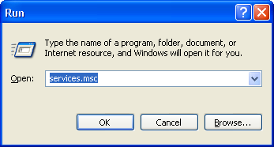
Restarting JBoss
In the production server,go to Start-> Run and type “Services.msc” and click ok

Slide 4
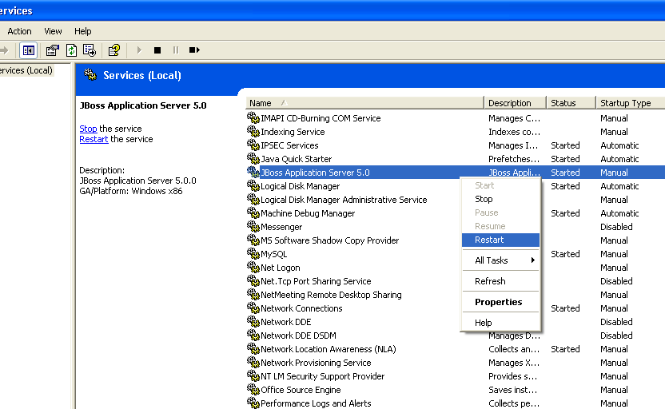
Restarting JBoss (contd…)
This will open the “Services” window as shown below.
Select and right click on “JBoss Application Server 5.0”
Click on “Restart”

Slide 5
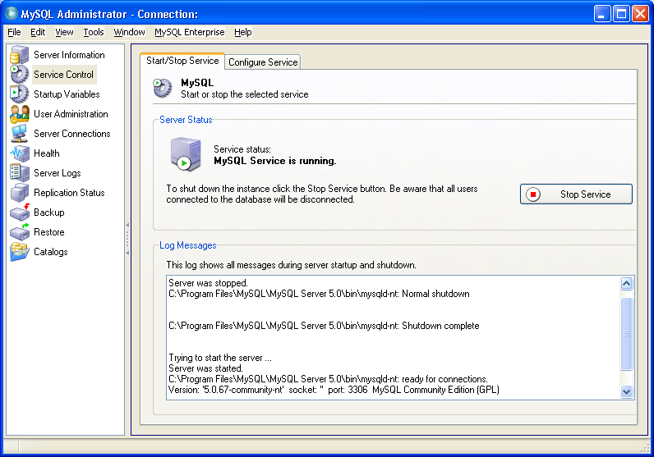
Restarting MySQL Database Server
Open the MySQL administrator console in the production server
Select “Service Control” tab in the upper left side and then click on “Stop service” on the right side to stop the server.

Slide 6
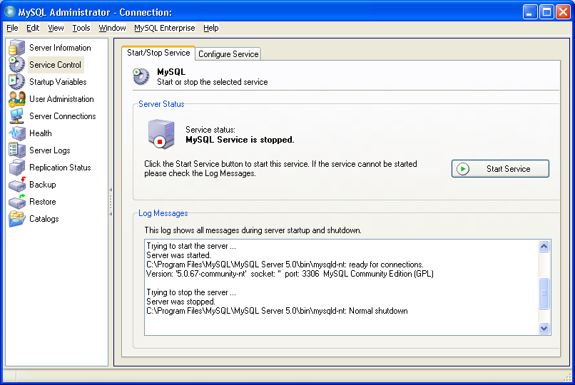
Restarting MySQL Database Server (contd..)
After the server is stopped the button changes to “Start Service”. Click on the “Start Service” button to restart the server

Slide 7
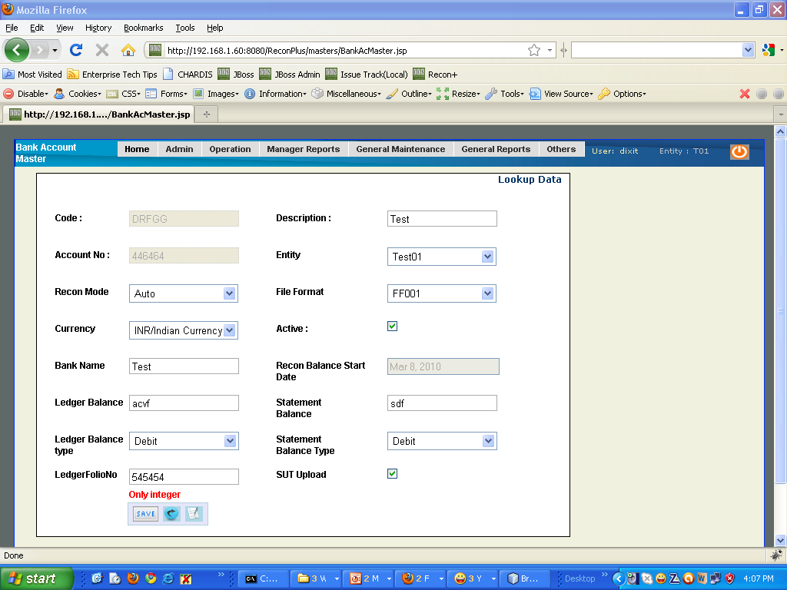
Recovering the System when a page stucks and the system hangs up
Sometimes entering of wrong data may cause the system to pause preventing users from navigating further.
For example in the below screenshot the user has entered wrong data in Ledger and Statement balance field,which expects numeric data.
If the user clicks on save the system hangs up preventing users from further navigation.

Slide 8
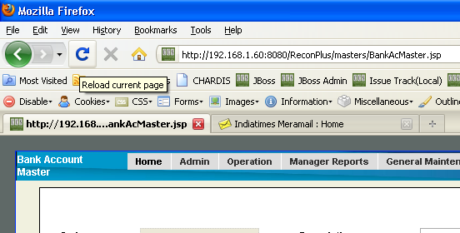
Recovering the System when a page stucks and the system hangs up (contd..)
To recover from this problem click the “refresh” button of the browser or press “F5”.

